Slide 1

AI-Driven Archaeological Site Mapping
AI for Heritage Conservation & Research

Slide 2

Challenges in Traditional Archaeological Site Analysis
1
2
Manual Surveys
Time-Consuming
Labor-intensive and prone to human error, often missing subtle details.
Extensive fieldwork and data processing prolong project timelines.
3
Erosion Risk
Vulnerable sites face continuous degradation, requiring urgent, efficient monitoring.

Slide 3










Project Objectives: Revolutionizing Conservation
Automate Analysis
Improve Accuracy
Leveraging advanced AI for rapid and comprehensive site assessment.
Minimizing human error and enhancing the precision of archaeological findings.
Support Conservation
Boost Efficiency
Providing critical data for proactive heritage preservation planning.
Significantly reducing time and resources required for site mapping.

Slide 4
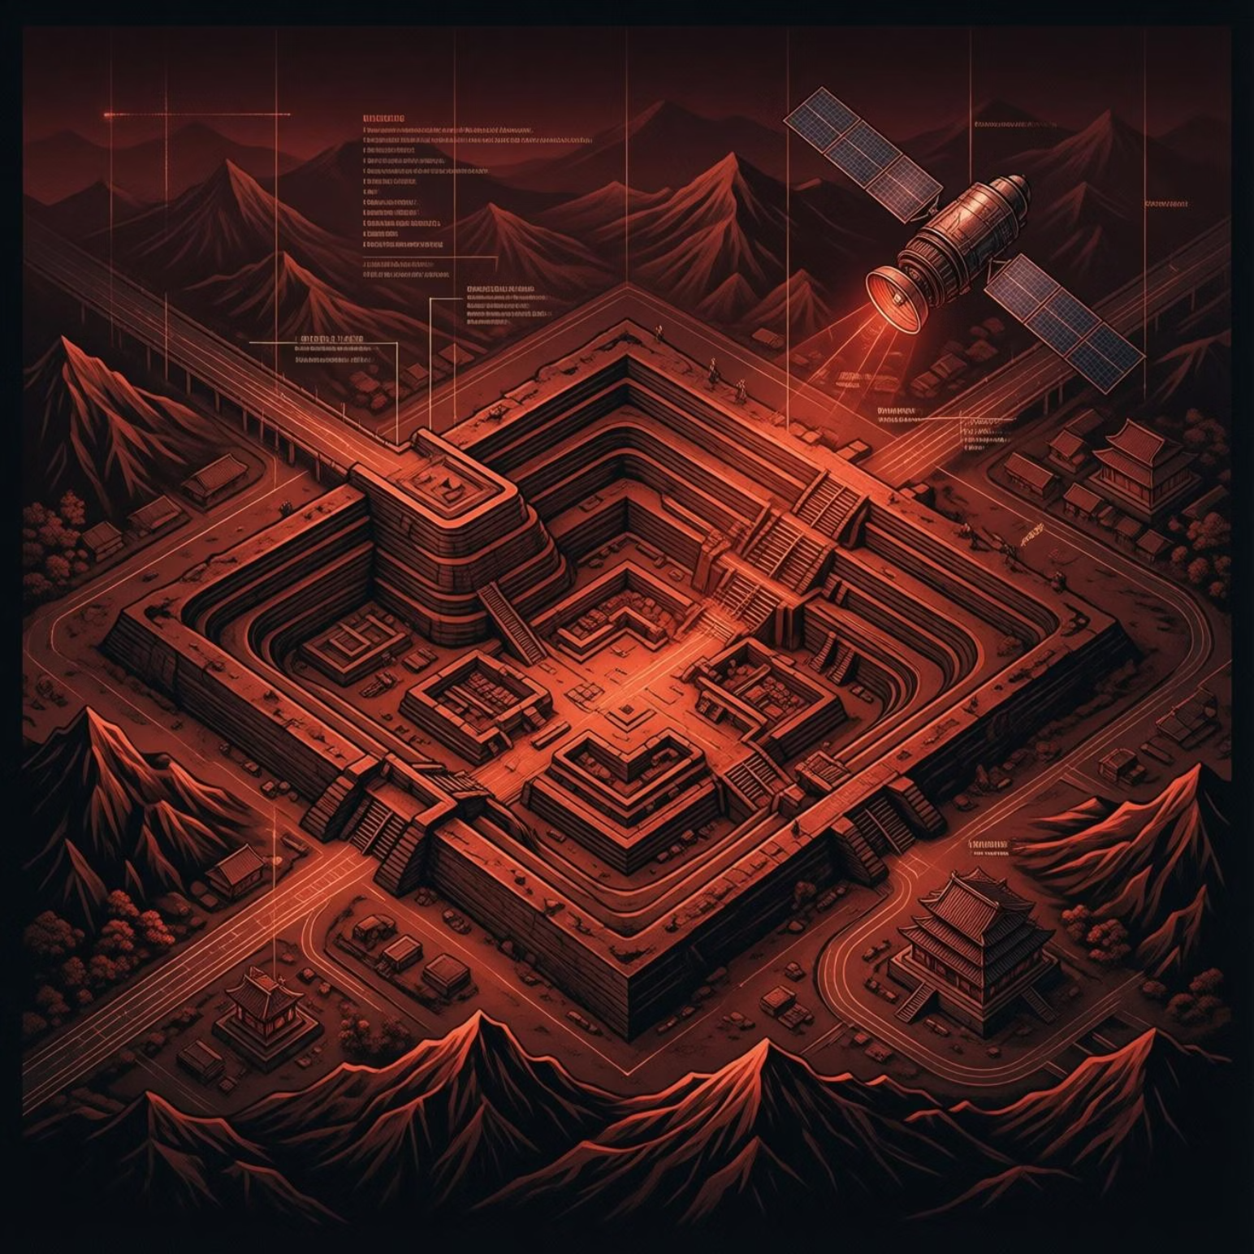


Diverse Data Sources for Robust Training
Google Earth ProHigh-resolution satellite imagery for broad contextual understanding and initial site identification.
OpenAerialMapCrowd-sourced and publicly available aerial photos offering diverse perspectives and historical views.
Custom Annotated DatasetsExpert-curated and labeled images crucial for training specialized AI models for archaeological features.

Slide 5





System Architecture Overview
A seamless flow from raw data to actionable insights.
Data Collection
Preprocessing
AI Models
Dashboard Visualization

Slide 6



Semantic Segmentation Module
Utilizing advanced deep learning models to precisely identify and delineate archaeological features.
U-Net / DeepLabState-of-the-art architectures for pixel-level classification.
Ruins & Vegetation SegmentationAccurately distinguishing ancient structures from surrounding natural elements.
Output VisualizationClear, color-coded maps highlighting segmented areas for easy interpretation.

Slide 7



Artifact Detection Module
Automated identification and classification of individual artifacts within broader site imagery.
YOLO Object DetectionReal-time capability for rapid artifact localization.
Bounding BoxesPrecise demarcation around detected objects for focused analysis.
Artifact ClassificationCategorizing findings (e.g., pottery, tools) based on learned features.

Slide 8
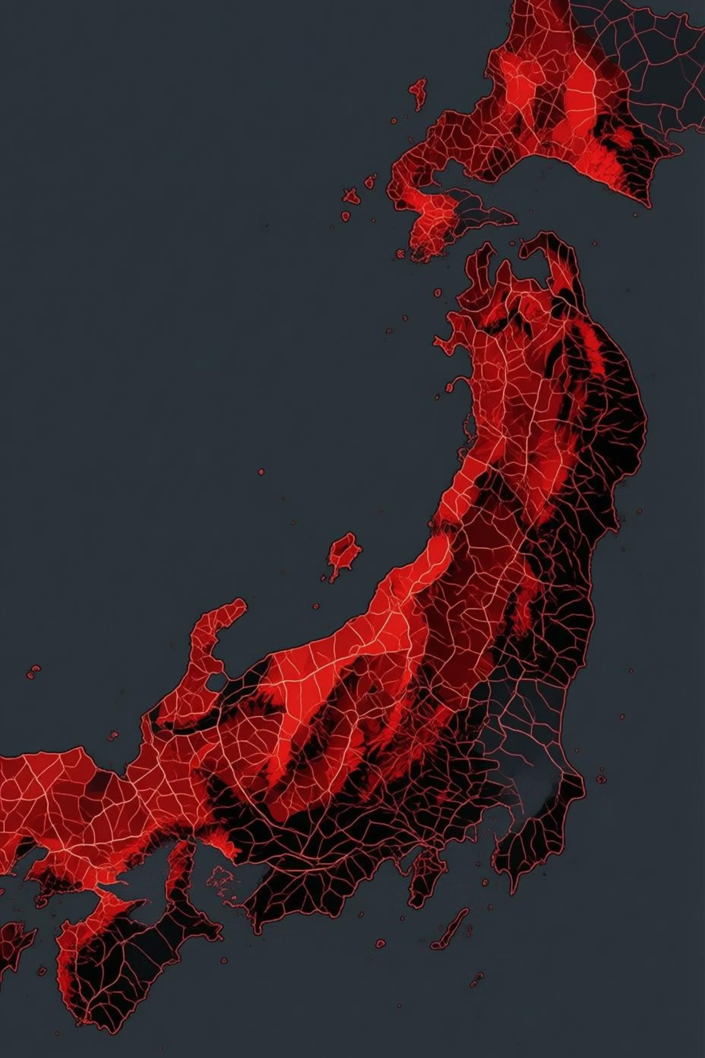




Terrain Erosion Prediction
Slope Analysis
Identifying steep gradients prone to rapid soil movement.
NDVI (Vegetation Index)
Assessing vegetation cover's role in soil stability.
Elevation Data
Understanding hydrological flow and gravitational forces.
Risk Classification
Predicting areas susceptible to erosion using Random Forest & XGBoost models.

Slide 9
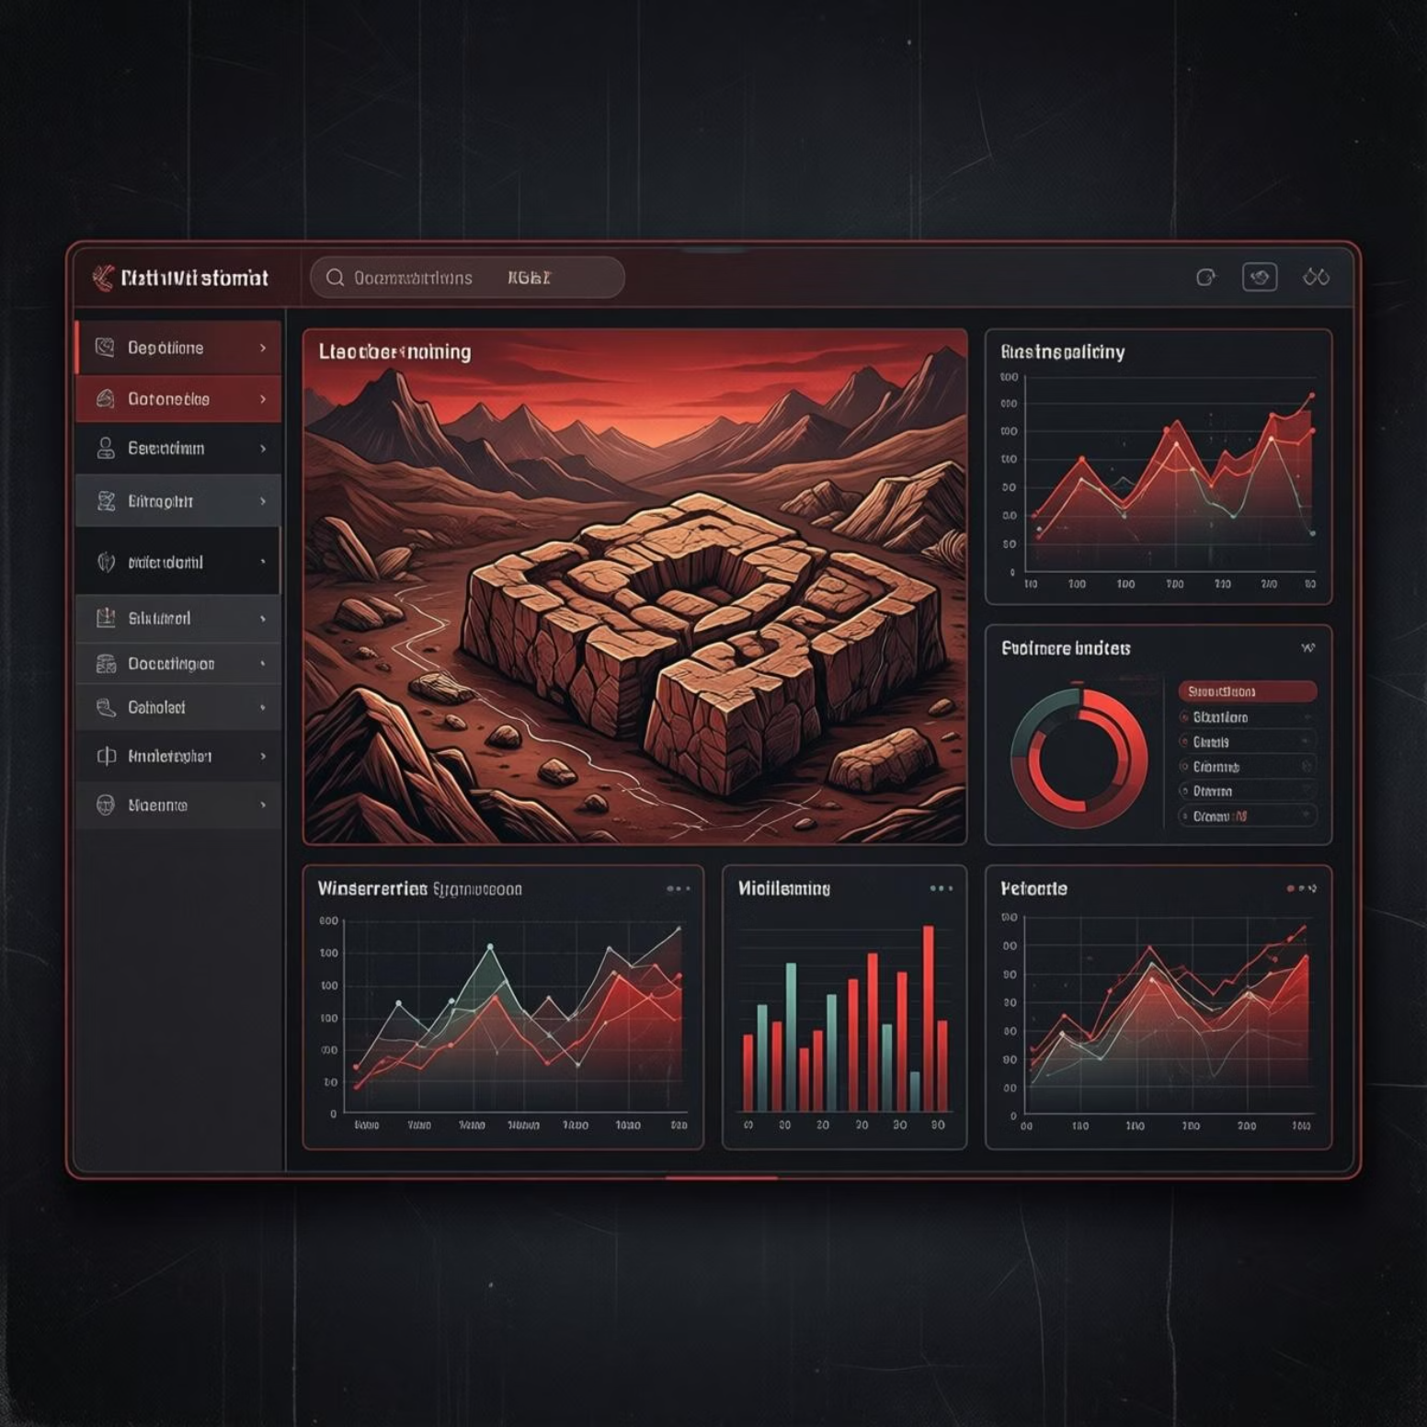

Interactive Dashboard & Web Platform
Intuitive InterfaceUser-friendly design for both technical and non-technical users.
Image/CSV UploadSeamless integration of new datasets for on-demand analysis.
Rich Visual OutputsSegmented maps, bounding boxes, and erosion risk assessments at a glance.
Collaborative ToolFacilitating data sharing and discussion among stakeholders.

Slide 10





Key Takeaways
Integrated AI Pipeline
Real-World Heritage Application
A holistic solution from data input to actionable insights, driving efficiency and precision.
Directly addressing critical needs in archaeological site conservation and research.
Full-Stack Implementation
A complete, deployable system ready for diverse archaeological challenges.

